Slide 1

Vehicle Loan Default Prediction
Final presentation
RAFAEL MOREIRA SILVEIRA
SPRINGBOARD – DATA SCIENCE CAREER TRACK
MENTOR – KENNETH GIL PASQUEL

Slide 2
Problem statement
Consequences of not fulfilling loan instalments to the borrower:
Incur in extra fees,
Credit Score drop,
Worst rates in the future.
Consequences of many loan defaults to financial institutions:
Higher premiums with third party insurance companies,
Simply “raising the bar” to grant loans affects their profitability and the whole economy.
Can we increase loan default predictability?

Slide 3
Proposal
Increase vehicle loan default predictability by analysing historical data. Steps:
Prepare the data for Classification Models
missing data,
outliers,
mistyped information,
wrong data type and
Exploratory Data Analysis
Explore Machine Learning Classification models
Define metrics and Benchmark to evaluate models
Explore different versions of the dataset
Explore several classification models
Parameters tweaking

Slide 4
Dataset
The dataset consists of borrower data (Demographic data like age, income, Identity proof etc.), loan data (Disbursal details, amount, EMI, loan to value ratio etc.) and Bureau data (Bureau score, number of active accounts, the status of other loans, credit history etc.). The .csv files may be found on the following URL:
https://www.kaggle.com/avikpaul4u/vehicle-loan-default-prediction
Consists of 233,154 rows and 40 columns.
The target column is called “LOAN_DEFAULT”, where 1 is the label associated to default.
Description of the columns on the last slides (Appendix).

Slide 5
Data Preparation
Missing data – only 3% of rows. Decision: drop
Data type conversions
2 columns: from string to Datetime
2 columns: from string (“1yrs 11mon”) to float (1.92 years)
6 columns: from integers to string (ID columns)
Creating 2 datasets – Which one will yield better predictions?
Df_full – all columns kept and a few added
Df_slim – several columns removed
Mistyped data – none found
Inconsistencies among columns – none found

Slide 6
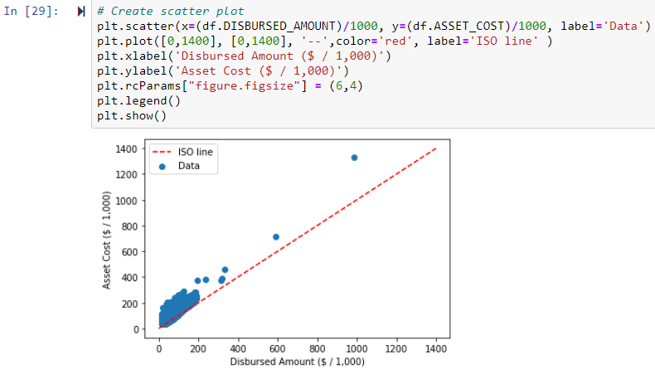
Outliers
Exploring the relationship between “DISBURSED_AMOUNT” and “ASSET_COST”:
Outliers are "aligned" with the rest of the data, so they are be kept
Notice how Asset Cost is always greater than the Disbursed Amount (above ISO line).

Slide 7
Exploratory Data Analysis – (1 / 5)
Analysing the target column LOAN_DEFAULT. Questions:
Is the Bureau Score reliable?
Does the default rate increase as the Disbursed Amount increase?
What is the Average Default Rate by Employment Type, State and Employee ID?
Is the age of the borrower relevant?

Slide 8
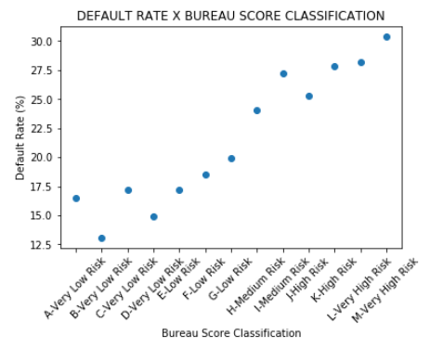
Exploratory Data Analysis – (2 / 5)
Is the Bureau Score Reliable?
Yes! We can easily identify an upwards trend.
Interesting: 20% gap between lowest and highest risk bins

Slide 9
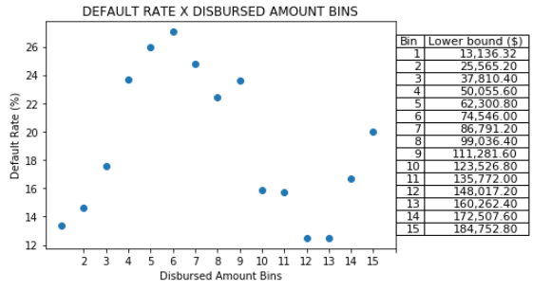
Exploratory Data Analysis – (3 / 5)
Does the Default Rate Increase as the Disbursed Amount Increases?
No! No linear relationship between the variables.

Slide 10
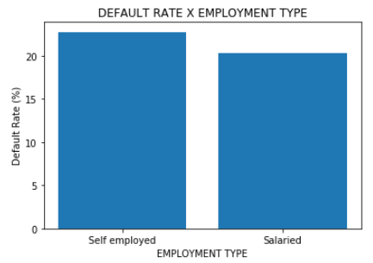
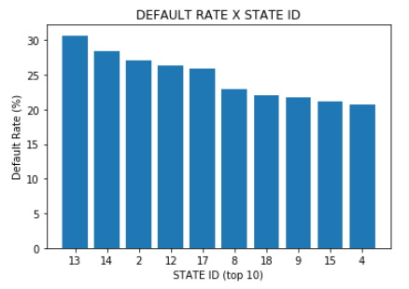
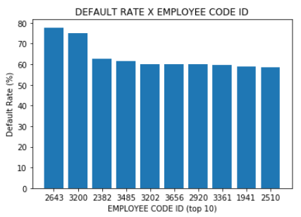
Exploratory Data Analysis – (4 / 5)
What is the Average Default Rate by Employment Type, State and Employee ID?
Contrary to my expectation, there is not a significant difference between Salaried and Self-employed customers
Relevant for multi-branch financial institution
There are Employees whose clients defaulted 80% of the time???
The average is 20%. Investigation? Training?

Slide 11
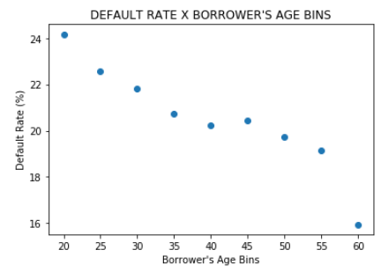
Exploratory Data Analysis – (5 / 5)
Is the Age of the Client Relevant?
A little! Younger people are (a little) more prone to default
Curiosity: why the gap between 55 – 60?
- States have more strict rules for over 60s?
- Psychological change that affects human beings at that age?

Slide 12
Data Exploration and Analysis Key Takeaways
The dataset did not require complex data wrangling techniques
The credit score is reliable: higher scores imply low default rate
Salaried and Self-employed customers are equally likely to default
Some employees have a staggering 80 % default rate
Client’s age and the Disbursed amount bears little to no relation with the default rate

Slide 13
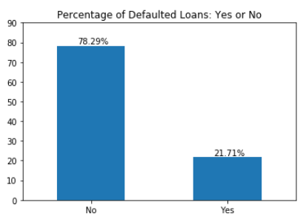
Machine Learning Classification Models – Metrics
Imbalanced Data
Must be considered when:
- splitting into train and test dataset
- applying ML models
- defining metric to compare models.
For imbalanced data, F1 Score is a good metric.
R Squared not appropriate:
only predictions = “No” results in accuracy = 78.3%

Slide 14
Machine Learning Classification Models –Benchmark
Two benchmarks:
Dummy: Sklearn’s Dummy Model
F1 Score: 0.218 → Score to beat
Challenging: Current classifying model!
Raw data comes from actual loans → Current model's prediction = “No”.
Challenging benchmark → raw data’s default rate X My model's predictions = “No”.

Slide 15
Machine Learning Classification Models –Models Exploration
ID`` | Model Family | Description (*1) | F1 Score | Recall (*2)
1 | Logistic Regression | max_iter=300, solver='sag' | 0 (no prediction =1) | 0
2 | kNeighbors | n_neighbors = 5 | 0.154 | 0.107
4 | Perceptron | (tol=1e-3, random_state=42, class_weight={0:1,1:3} | 0.333 | 0.629
5.1 | Linear Discriminant Analysis (*3) | 'priors': [0.4, 0.5] NOTE: true priors: [0.78, 0.22] | 0.379 | 0.901
5.2 | Linear Discriminat Analysis | No tweaking | 0.007 | 0.004
6 | Random Forest Classifier | n_estimators=100 | 0.061 | 0.033
7 | Multi-layer Perceptron classifier | max_iter=300 | 0.000 | 0.000
8 | Gradient Boosting Classifier | No tweaking | 0.006 | 0.003
9.1 | Support Vector Machine | gridCV (to define the gamma parameter) and StandardScaler() | Execution interrupted (> 20 minutes)
9.2 | Support Vector Machine | gridCV only | Execution interrupted (> 20 minutes)
9.3 | Support Vector Machine | StandardScaler() only | Execution interrupted (> 20 minutes)
3 | Stochastic Gradient Descent Classifier | class_weight='balanced', | 0.377 | 0.657
(*1) – gridSearchCV used to define the parameters.
(*2) – Recall: out of all the customers who defaulted, how many did my model identify?
(*3) – Artificial priors. Overfitting the testing data, cannot be used.
Best “out-of-the-box” model: Stochastic Gradient Descent Classifier
Dummy benchmark beaten by a lot
(0.37 > 0.21)
Using this model, let’s define:
Best dataset (full or slim),
Best parameters
Compare to the Challenging benchmark

Slide 16
SGD Classifier - Best dataset
During models testing, 4 datasets were generated with varying number of columns. Here is how the metrics compare:
ID | Model Family | Dataset used | F1 Score | Recall
3.1 | Stochastic Gradient Descent Classifier | - Full Dataset - function used: prepData | 0.379 | 0.666
3.2 | Stochastic Gradient Descent Classifier | - Full Dataset - function used: prepDataSlim | 0.378 | 0.657
3.3 | Stochastic Gradient Descent Classifier | - Slim Dataset - function used: prepData | 0.388 | 0.677
3.4 | Stochastic Gradient Descent Classifier | - Slim Dataset - function used: prepDataSlim | 0.380 | 0.752
Third model has a better F1 score. Fourth model has a 75% Recall rate. It makes sense to sacrifice very little precision to have a significant increase in the recall rate.
Best dataset = slimmer version of df_slim!
From now on, I am using this dataset.
Ps: Please find “prepData” and “prepDataSlim” function definitions in the appendix

Slide 17
SGD Classifier - Parameters Tweaking
Considering F1 scores and Recall Rates, here are the parameters tested:
Penalty – Tried 10 values for L1_ratio (elasticnet).
Best = default (L1_ratio = 0, meaning only L2 penalty)
Alpha – Tried 5 values
Best = default (alpha = 0.0001)
Alpha = 0.01 produces slightly better F1 Score, but worst Recall Rate
class_weight – “balanced” proved to be better

Slide 18
Challenging Benchmark – Current Model X My Model (1 / 2)
Overall Default Rate Prediction Accuracy
Considering predictions = “No”, my precision is 15%
Significantly lower than the 21.7% default rate we observe in the raw data.
My model makes 50 % error when it comes to identifying non-default customers
But is 75% accurate to identify customers likely to default.
We do not have these last two metrics regarding the current model, so we cannot compare.

Slide 19
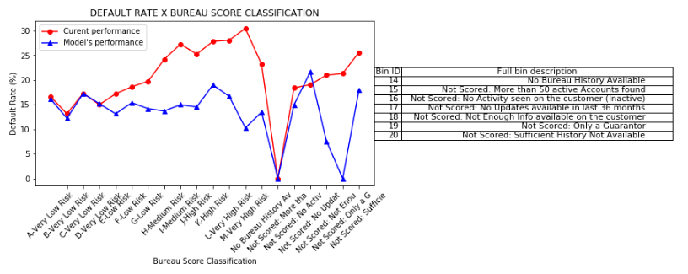
Challenging Benchmark – Current Model X My Model (2 / 2)
Default Rate Prediction Accuracy by Credit Score Bins
My model outperforms the current model in almost all ranges of credit score (lower Default Rate is better)

Slide 20
Models Exploration key Takeaways
Slimmer version of the dataset yielding the best prediction.
Powerful computers instigate us to use every feature we have.
In this case, this would be a bad strategy.
Recommendation - If a customer asks for a loan:
Run my model.
If prediction = “No” → Lower rate could be applied (chance of default ~ 15%)
If prediction = “Yes” → Further investigation is required
Is the number of clients being rejected too high?
Is the loaning company risk-prone?
Should other business strategies be considered?

Slide 21
Conclusion
I went all the way from loading the raw dataset to proposing a good classification model
The model proposed beats two benchmarks: Scikit Learn’s Dummy Model, and a more “challenging” benchmark, which consists of comparing the model to the existing model, the one that generated the raw file. Fortunately, the model proposed has a better predicting accuracy for every type of client, according to the bureau’s classification: from the most “risky” (low score) to the less risky (high score)
My model should be used as stated on the previous slide
For detailed information, please refer to the report “Final Report.pdf”, also found in the same Github folder where this presentation is stored

Slide 22
Appendix - Columns description

Slide 23
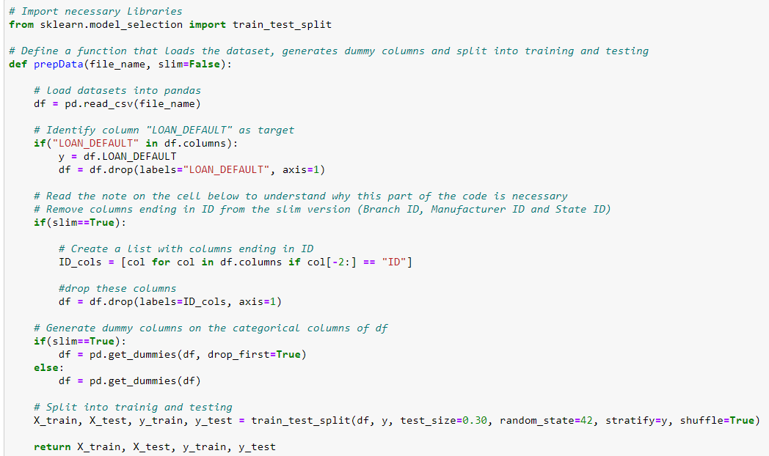
Appendix – Function prepData

Slide 24
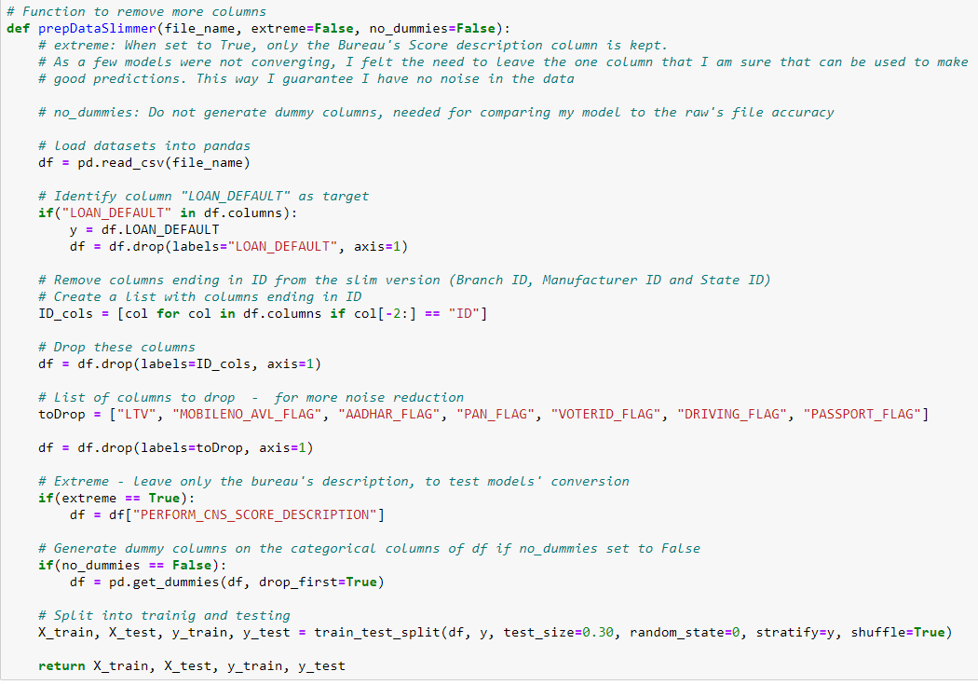
Appendix – Function prepDataSlim

